Slide 1


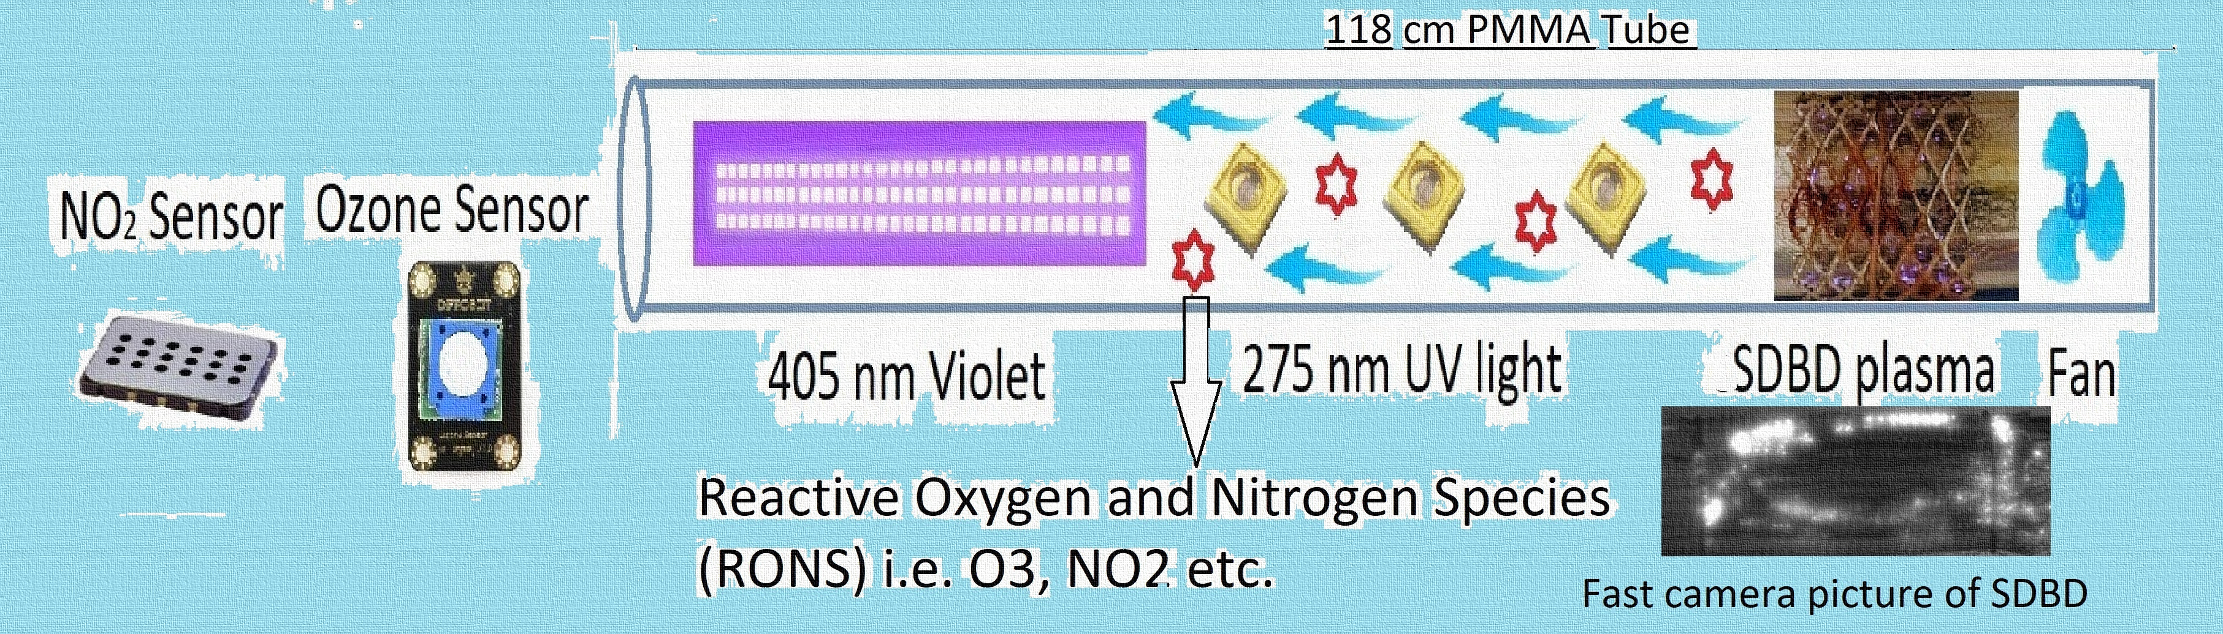

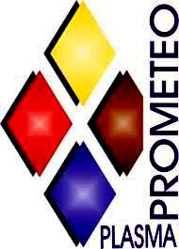




SDBD air plasma source equipped with environmental sensor for application to bacteria inactivation
M. M. Rashid, R. Barni, C. Riccardi
Dipartimento di Fisica G.Occhialini, Università degli Studi di Milano-Bicocca,
piazza delle Scienza 3 - Milano I-20126, ITALY
Introduction and Motivations
The underlying study incorporates the ideas of indoor air sanitation techniques for better environmental quality of living space under pilot 2.4 of ANTHEM project “Wide spectrum light and devices to sanitize surface and air”.
Air contamination due to pathogenic microorganisms is a serious environmental problem and risks human race due to their contagious nature. This work is a proof of concept to propose a sophisticated device that could deactivate the airborne pathogens (e.g. bacteria, fungus, virus etc.)
In order to efficiently deactivate airborne bacteria (e.g. Escherichia coli) a novel SDBD air plasma apparatus equipped with some environmental sensors has been investigated in this work. Ultraviolet and Violet light sources are integrated along with SDBD plasma as shown in Figure-1 to exploit the efficacy of these light sources for the production ozone. Surface Dielectric Barrier Discharge plasma is a widely explored tool for VOC depletion[1,2] .
Surface DBD air plasma, an excellent way to generate non-thermal plasma in atmospheric pressure, and capable of producing free electrons, ions and numerous RONS- (Reactive Oxygen and Nitrogen Species), has been designed and the gas-phase chemistry was investigated by Optical Emission Spectroscopy[3,4].
Materials and Methods
Figure-1: Experimental setup of cylindrical Surface Dielectric Barrier Discharge (SDBD) air plasma combined with UVC and Violet light Source
Results
Figure-2: Ozone concentration as a function of duty cycle (DC) variation on various events (Plasma, UV, violet light On-Off).
Figure-3: Nitrite concentration as a function of duty cycle (DC) variation on various events (Plasma, UV, violet light On-Off).
Discussion
References
The overall study reveals that the ozone concentration (Figure-2) can be varied by varying the duty cycle of the pulse to generate the SDBD air plasma. There is no effect of UVC and Violet light on the overall concentration of ozone.
The other RONs, specially the concentration of ${NO}_{2}$ (Figure-3) is slightly beyond the standard value within a room and this is also independent of other light sources except the duty cycle (DC) to generate SDBD discharge.
Future work will focus on optimizing the RONS concentration to threshold levels and inactivating airborne bacteria.
[1] C. Piferi et al. Appl. Sci. 2022, 12, 4253 (2022).
[2] C. Piferi et al. Cleaner Engineering and Technology, Volume 8, 2022,
[3] Pierotti, G., Piferi, C., Popoli, A., Plasma Sources Science and Technology, 2023, 32(6), 064005.
[4] Biganzoli I., Barni R., Riccardi C., 2013, Journal of Physics D: Applied Physics, 46 (2), 025201
Acknowledgements
This work has been funded by the National Plan for NRRP Complementary Investments (PNC, established with the decree-low 6 May 2021, n.59, converted by law n. 101 of 2021) in the call for the funding of research initiatives for technologies and innovative trajectories in the health and care sectors (Directorial Decree n. 931 of 06-06-2022) – project n. PNC0000003-AdvanNced Technologies for Human-centrEd Medicine (project acronym: ANTHEM). Thanks to the company Artemide in the person of the President and CEO Arch. Carlotta de Bevilacqua and the technical team that collaborates on the project Anthem "Wide spectrum light and devices for sanitation analyses" composed by Andrea Gallucci, Laura Pessoni, Silvia Marinoni and Roberto Franzosi.
50th EPS Conference on Plasma Physics, 8~12 July 2024, Salamanca, Spain

